Slide 1




Final Project
Data Science
Predicting Delivery Delays with ML
GET STARTED
Deni Ansyah

Slide 2
About Me!
I am a second-semester undergraduate student majoring in Information Systems with a growing passion for data science—especially in the area of data analysis. My academic journey has sparked my curiosity in how data can be transformed into meaningful insights that support better decision-making in various industries.
While I am still early in my university career, I have proactively explored the world of data by studying tools such as Python, Excel, and SQL, and learning how to apply them in real-world scenarios like data cleaning, visualization, and simple predictive modeling. I am particularly interested in understanding user behavior, business performance, and how data storytelling can influence strategic actions

Slide 3


Table of Contents
01
02.
03.
04.
Business Understanding
Data Overview
Workflow
EDA
05.
06.
07.08
Model Selection
Features Contribution
Conclusion
Recommendations

Slide 4

Business Understanding
An e-commerce company aims to analyze its shipping data to predict whether an upcoming delivery is likely to be delayed or not. Several variables that are believed to influence shipping performance have been collected. The company also intends to evaluate the extent to which each variable contributes to the prediction of delivery delays. The most influential variables will become the focus of relevant teams in order to proactively mitigate delays in the future.
There are two main objectives of this analysis:
To assess how much influence each variable has on the delivery status.
To build a predictive model to determine whether a shipment is likely to experience a delay.

Slide 5
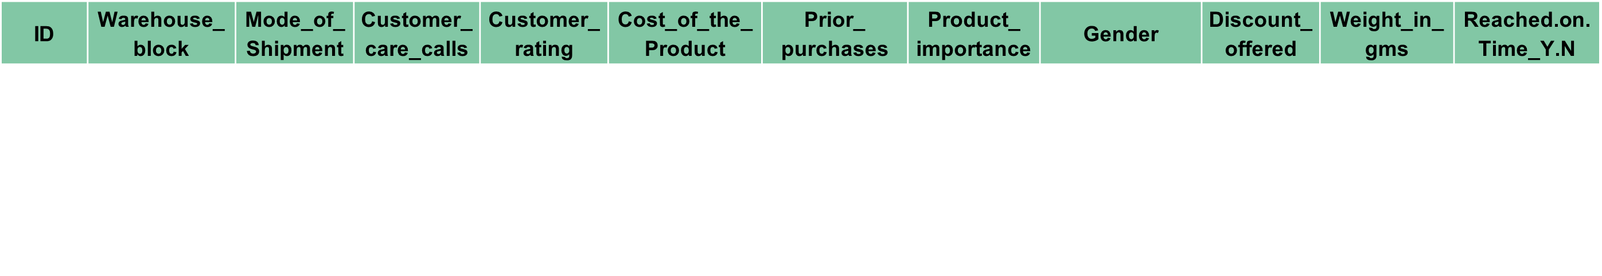
Data Overview
E-Commerce Shipping Data
Dataset contains 10.999 rows with 12 features
Features:
Warehouse block : The Company have big Warehouse which is divided in to block such as A,B,C,D and F
Mode of shipment : The Company Ships the products in multiple way such as Ship, Flight and Road.
Customer care call : The number of calls made from enquiry for enquiry of the shipment.
Customer rating : The company has rated from every customer. 1 is the lowest (Worst), 5 is the highest (Best).
Cost of the product : Cost of the Product in US Dollars.
Prior purchases : The Number of Prior Purchase.
Product importance : The company has categorized the product in the various parameter such as low, medium, high.
Gender : Male and Female.
Discount offered : Discount offered on that specific product.
Weight in gms : It is the weight in grams.
Reached on time : It is the target variable, 1 Indicates that the product has reached on time and 0 indicates it has NOT reached on time.
cost_after_discount : (Cost of the Product) * (Discount offered)
Keterangan:
Drop
New features

Slide 6











Workflow
The method used is a classification technique involving several algorithms. The best-performing method will be selected based on predefined evaluation metrics.
The methods include: Logistic Regression, Decision Tree, Random Forest, XGBoost, and LightGBM.
The evaluation metric used is the F1 score, as the company considers it important to minimize all types of prediction errors, making the F1 score the most suitable choice.
1
Evaluation model using F1 score
Preprocessing Data:
Data Understanding & EDA
Modeling using:
Use the model for future shipping forecasting
Change column names
Missing value check
Data duplicated check
Outlier check
Categorical encoding
Split data (train and test)
Logreg
Decision tree
Random forest
XGBoost
LightGBM
Choosing the best model based on the highest F1 score

Slide 7
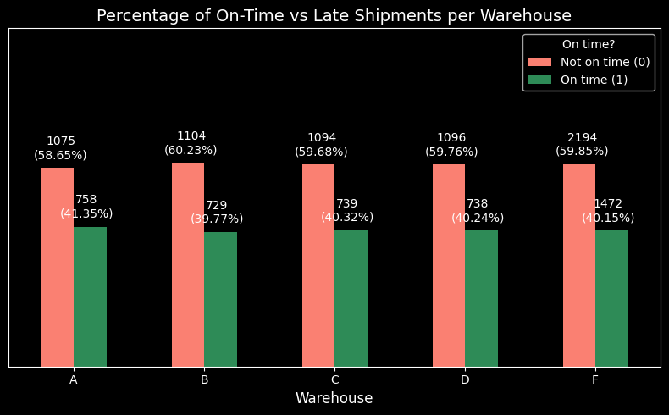
EDA 1
Do certain warehouses tend to have more delays?
All warehouses have a delay percentage of over 50%.
Warehouse B has the highest delay percentage compared to the other warehouse.

Slide 8
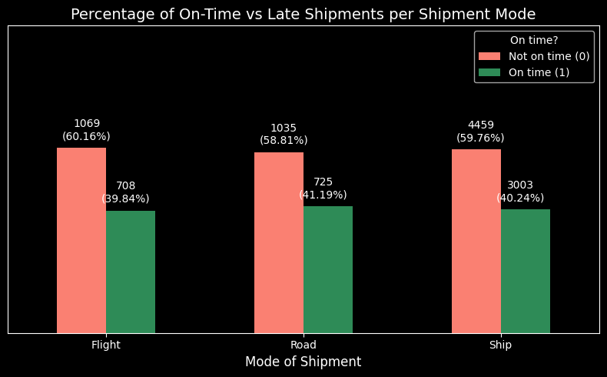
EDA 2
Which shipment mode is most often on time?
All shipment modes have a delay percentage of over 50%.
Flight has the highest delay percentage compared to other shipment modes.
Road has the highest on-time delivery percentage among all shipment modes.

Slide 9
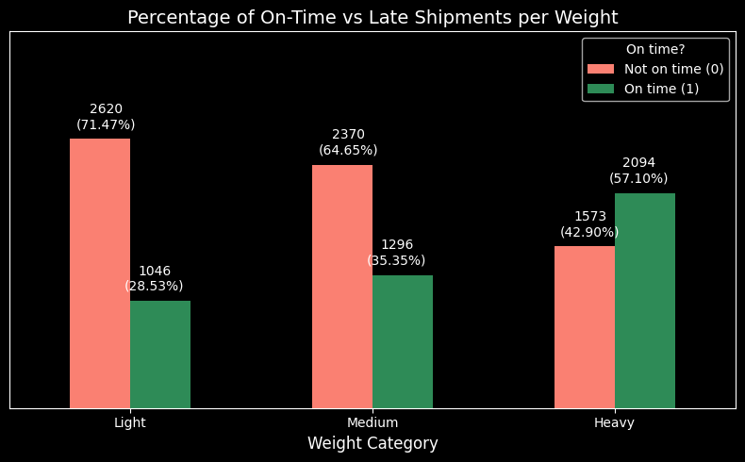
EDA 3
Do heavier products tend to be delayed?
Products in the lightweight category tend to experience more delays.
Products in the heavyweight category are generally delivered faster or more often on time.

Slide 10
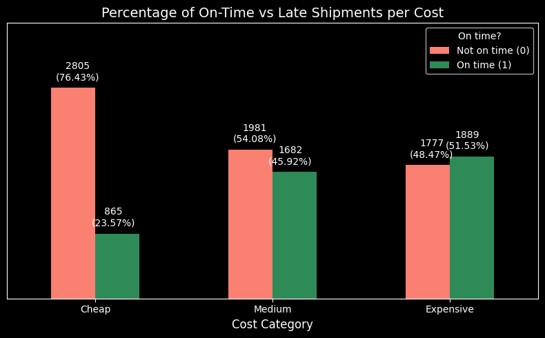
EDA 4
Do lower-priced products result in more shipments and more frequent delays?
Low-priced products tend to experience more delays.
What’s important to highlight is that, although low-cost products do not lead to a significant increase in the number of shipments (all three cost categories have around 3,660 shipments), the delay percentage for low-cost products is relatively high compared to the other cost categories.

Slide 11
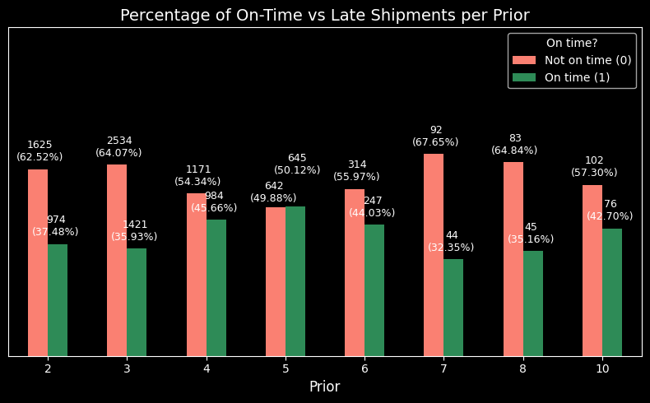
EDA 5
How is the pattern of delivery status between customers?
In general, customers who frequently make shipments tend to not experience delivery delays.
However, there is an anomaly where customers who have previously made shipments 7 to 8 times also often experience delays.

Slide 12
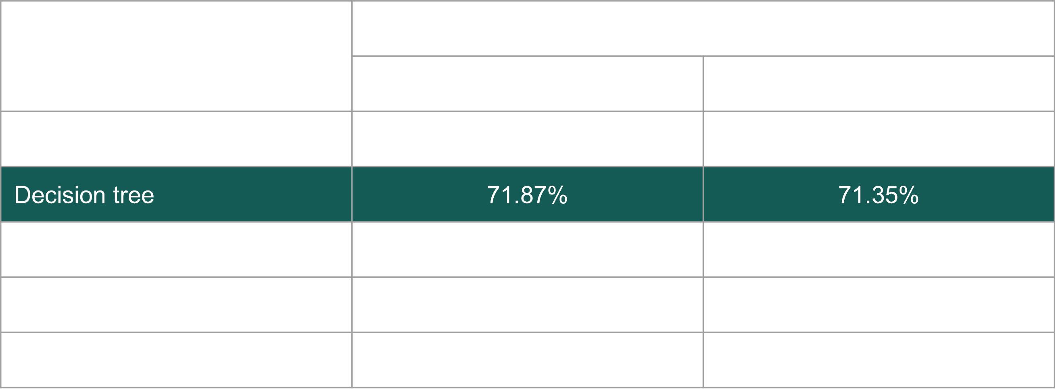
Model Selection
Although Random Forest achieved the highest F1 score on the training set, it experienced a significant drop in performance on the test set. This indicates a tendency toward overfitting, where the model performs well on training data but poorly on unseen data.
Therefore, Decision Tree is considered the best model, as it demonstrates more stable performance and achieves the highest F1 score on both the training and test sets compared to other stable models.

Slide 13
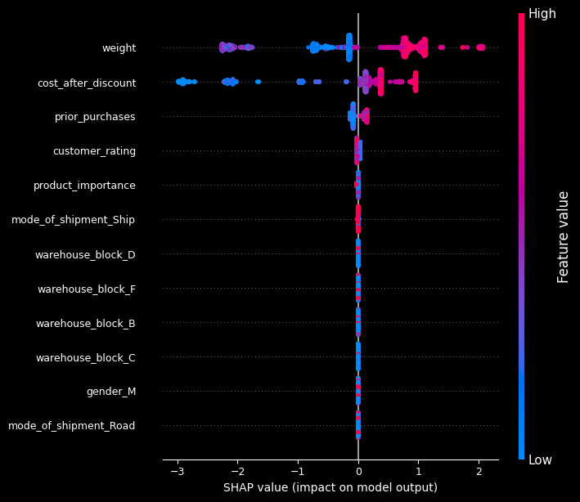
Features Contribution
There are three features that contribute most significantly to the delivery status (on-time or delayed):
Weight: the heavier the item, the faster it arrives.
Cost after discount: the higher the price of the item, the faster it arrives.
Prior purchases: the more frequently a customer shops, the faster their ordered items arrive.

Slide 14
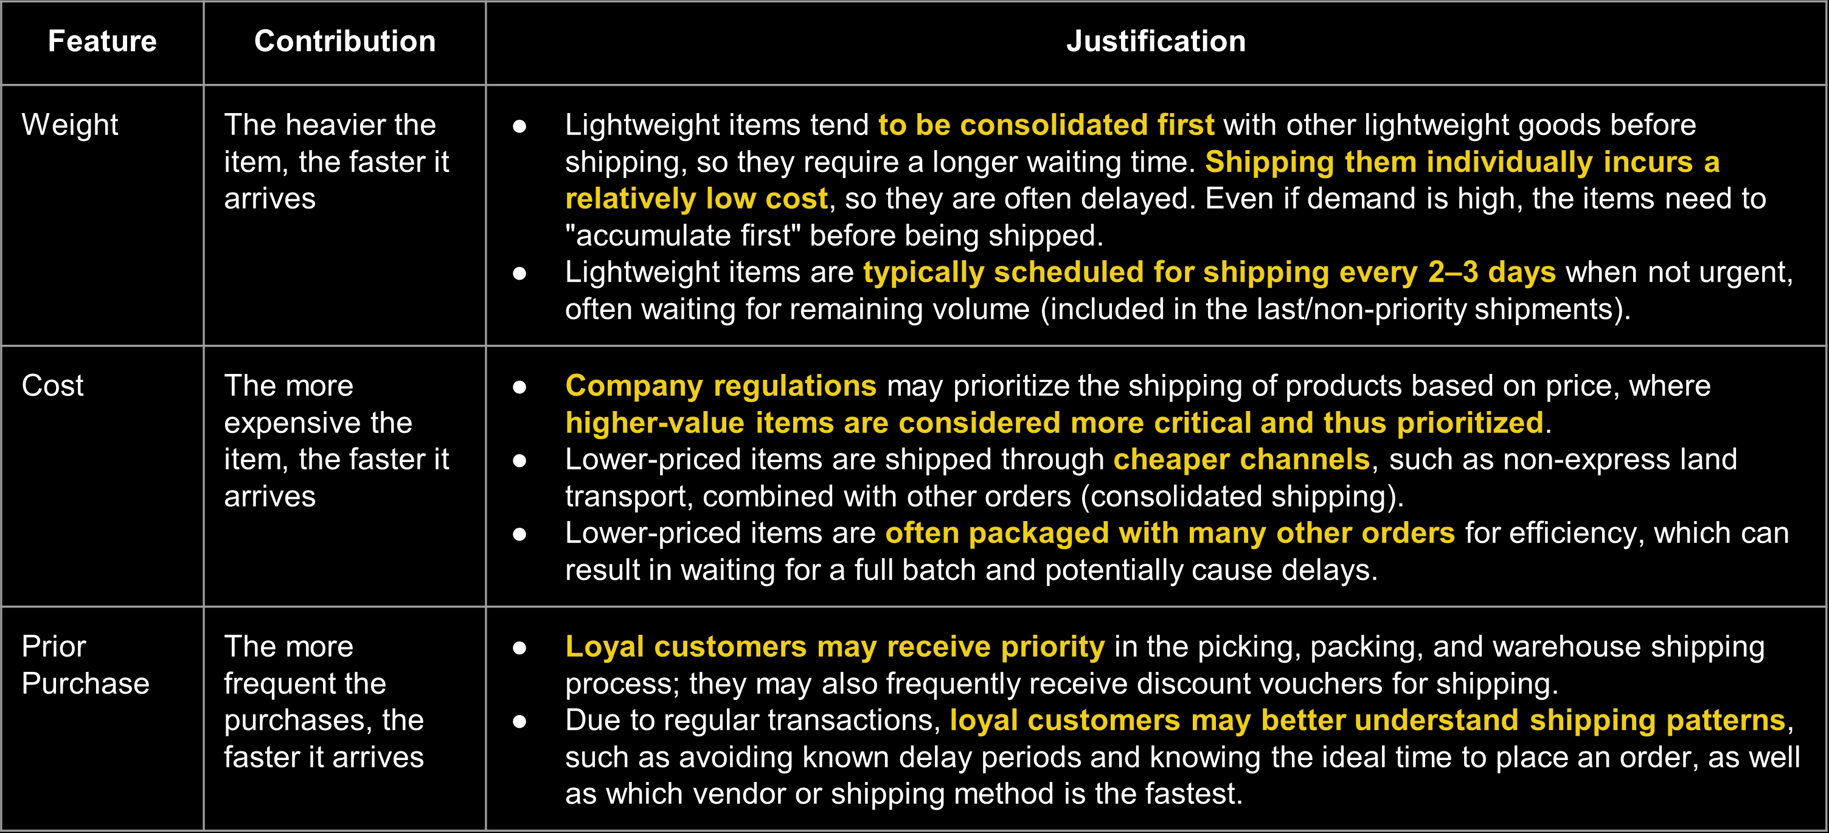
Features Contribution

Slide 15
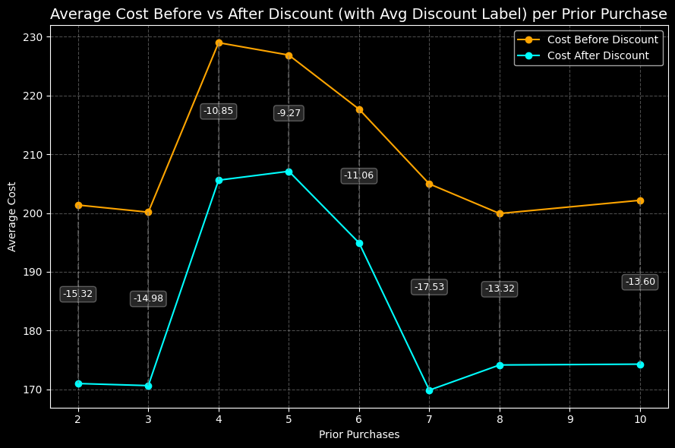
Features Contribution
Customer behavior:
The table shows that middle customers—those who have made 4 to 6 shipments—tend to ship higher-cost goods. This may indicate that they trust the company with their expensive items, which could make their shipments a priority.
Meanwhile, customers with 7 prior purchases—who are more loyal—typically receive the highest discount percentage. This suggests that they frequently get special discounts as part of the company’s loyalty program.

Slide 16
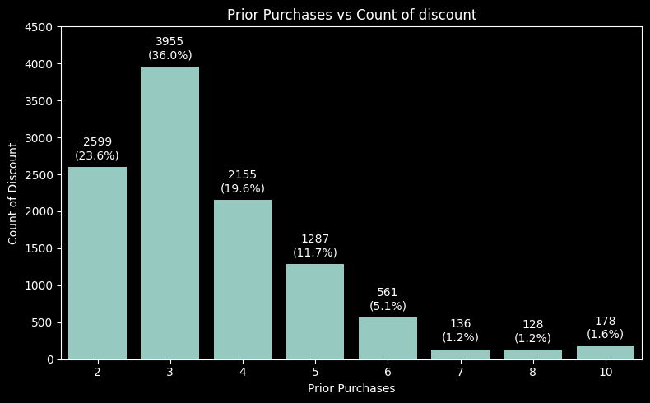
Conclusion:
Based on the charts showing an overview of the data, several key points can be highlighted:
The data shows a fairly even distribution across different modes of shipment. This indicates that regardless of the shipment mode, the distribution of on-time and late deliveries is relatively similar.
Products with higher weight or cost are actually more likely to arrive on time, and the graph indicates that the heavier and more expensive the item, the higher the likelihood it will be delivered on time.
The Decision Tree model was selected as the best-performing model based on model stability and the F1 score metric.
There are three features with the highest contribution in predicting whether a delivery will be late or on time, namely: weight of product, cost of product (after discount), and prior purchase.
Recommendations:
Add other relevant features such as distance/travel time, destination location or store location, order time (hour/day/date/month), number of products, product category (electronics, clothing, food, etc.).
Pay attention to smaller-sized and/or lower-priced products to reduce delivery delays.
Offer discounts only during specific events or occasions, ensuring they do not coincide with periods of high shipping demand (such as weekends, holidays, etc.). We need order time data for further analysis.
Based on the graph, most of the discounts are given to new customers. This is a great strategy to attract them, but it needs to be supported by a sufficient delivery fleet to avoid delays, especially for new customers.

Slide 17

Thank You
Get in touch!
Deni Ansyah
Attachments
Google collab
Dataset

